Slide 1
State of the Division
Reporting for 2014-2015

Slide 2
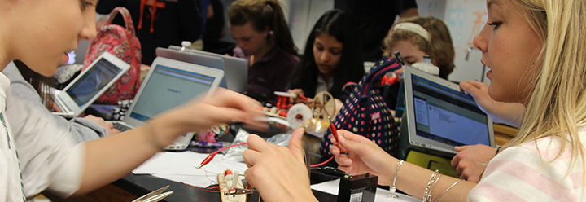
Goal
All Albemarle County Public Schools students will graduate having actively mastered the lifelong-learning skills they need to succeed as 21st century learners, workers and citizens.

Slide 3
Objectives
  Engage Every Student
  Implement Balanced Assessments
  Improve Opportunity & Achievement
  Create & Expand Partnerships
  Optimize Resources

Slide 4
Strategies
All students will graduate prepared for citizenship, post-secondary education, and workforce entry levels as evidenced by multiple indicators of lifelong learning competencies.
Increase the number of students accruing college credits and career pathway credentials prior to graduation.
Increase the efficacy of our instructional staff by developing the pedagogical expertise essential to contemporary learning.
Achieve a fully-funded capital and operational budget that meets the school system’s needs for learning space modernization, instructional innovation, digitized learning, and competitive recruitment and retention of personnel. Optimize the use of all allocated fiscal resources to meet the goals of the division.

Slide 5
Exemplars of Success
Graduation and Dropout Rate
  Standout was in ESOL
Climate Data Improvements
Middle School math growth for non-High School Courses
Implementation of Performance Tasks at all Grade Bands
Growth of Virtual Course Development and Participation
AVID
  Growth in Participation and Students Enrolling in Higher Education

Slide 6
Challenges
Demonstrate that:
  Our students are making progress in our healthy/active lifestyle Life Long Learning Competency
  Overall gap data for memberships groups across our multiple assessments is decreasing
  Math and literacy performance is increasing for all students

Slide 7
https://www2.k12albemarle.org/acps/division/report/Pages/default.aspx

Slide 8
Our 2015 Response to the Challenges
Innovating:
  Reimagining of Yancey Elementary School
  Team19 at Albemarle High School
  Multi-Age approach at Agnor-Hurt Elementary School and other schools
  Creation of a data warehouse and student dashboards for staff
  Virtual Physical Education and fitness centers within our schools
Refreshing:
  Principal meeting focuses on student performance and climate data
  School Improvement Planning and Mid-Year Review has been aligned to meet today’s challenges
  Professional Learning Communities professional development and focus

